Slide 1
Guide to Computer Forensics and Investigations
Third Edition
Chapter 14
Report Writing for High-Tech Investigations

Slide 2
Objectives
Explain the importance of reports
Describe guidelines for writing reports
Explain how to use forensics tools to generate reports
Guide to Computer Forensics and Investigations

Slide 3
Understanding the Importance of Reports
Communicate the results of your investigation
  Including expert opinion
Courts require expert witness to submit written reports
Written report must specify fees paid for the expert’s services
  And list all other civil or criminal cases in which the expert has testified
Deposition banks
  Examples of expert witness’ previous testimonies
Guide to Computer Forensics and Investigations

Slide 4
Limiting a Report to Specifics
All reports to clients should start with the job mission or goal
  Find information on a specific subject
  Recover certain significant documents
  Recover certain types of files
Before you begin writing, identify your audience and the purpose of the report
Guide to Computer Forensics and Investigations

Slide 5
Types of Reports
Computer forensics examiners are required to create different types of reports
Examination plan
  What questions to expect when testifying
  Attorney uses the examination plan to guide you in your testimony
  You can propose changes to clarify or define information
  Helps your attorney learn the terms and functions used in computer forensics
Guide to Computer Forensics and Investigations

Slide 6
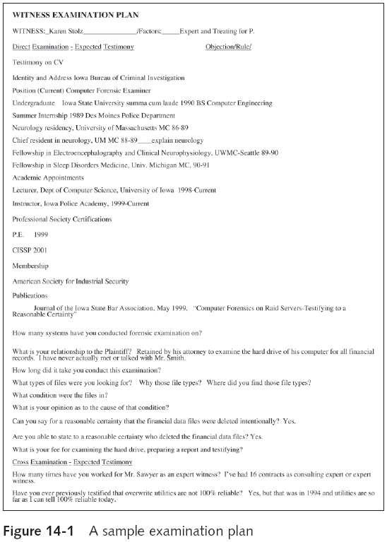
Guide to Computer Forensics and Investigations

Slide 7
Types of Reports (continued)
Verbal report
  Less structured
  Attorneys cannot be forced to release verbal reports
  Preliminary report
  Addresses areas of investigation yet to be completed
    Tests that have not been concluded
    Interrogatories
    Document production
    Depositions
Guide to Computer Forensics and Investigations

Slide 8
Types of Reports (continued)
Written report
  Affidavit or declaration
  Limit what you write and pay attention to details
    Include thorough documentation and support of what you write
Guide to Computer Forensics and Investigations

Slide 9
Guidelines for Writing Reports
Hypothetical questions based on factual evidence
  Less favored today
  Guide and support your opinion
  Can be abused and overly complex
Opinions based on knowledge and experience
Exclude from hypothetical questions
  Facts that can change, cannot be used, or are not relevant to your opinion
Guide to Computer Forensics and Investigations

Slide 10
Guidelines for Writing Reports (continued)
As an expert witness, you may testify to an opinion, or conclusion, if four basic conditions are met:
  Opinion, inferences, or conclusions depend on special knowledge or skills
  Expert should qualify as a true expert
  Expert must testify to a certain degree of certainty
  Experts must describe facts on which their opinions are based, or they must testify to a hypothetical question
Guide to Computer Forensics and Investigations

Slide 11
What to Include in Written Preliminary Reports
Anything you write down as part of your examination for a report
  Subject to discovery from the opposing attorney
Considered high-risk documents
Spoliation
  Destroying the report could be considered destroying or concealing evidence
Include the same information as in verbal reports
Guide to Computer Forensics and Investigations

Slide 12
What to Include in Written Preliminary Reports (continued)
Additional items to include in your report:
  Summarize your billing to date and estimate costs to complete the effort
  Identify the tentative conclusion (rather than the preliminary conclusion)
  Identify areas for further investigation and obtain confirmation from the attorney on the scope of your examination
Guide to Computer Forensics and Investigations

Slide 13
Report Structure
Structure
  Abstract
  Table of contents
  Body of report
  Conclusion
  References
  Glossary
  Acknowledgements
  Appendixes
Guide to Computer Forensics and Investigations

Slide 14
Writing Reports Clearly
Consider
  Communicative quality
  Ideas and organization
  Grammar and vocabulary
  Punctuation and spelling
Lay out ideas in logical order
Build arguments piece by piece
Group related ideas and sentences into paragraphs
  Group paragraphs into sections
Guide to Computer Forensics and Investigations

Slide 15
Writing Reports Clearly (continued)
Avoid jargon, slang, and colloquial terms
Define technical terms
  Consider your audience
Consider writing style
  Use a natural language style
  Avoid repetition and vague language
  Be precise and specific
  Use active rather than passive voice
  Avoid presenting too many details and personal observations
Guide to Computer Forensics and Investigations

Slide 16
Writing Reports Clearly (continued)
Include signposts
  Draw reader’s attention to a point
Guide to Computer Forensics and Investigations

Slide 17
Designing the Layout and Presentation of Reports
Decimal numbering structure
  Divides material into sections
  Readers can scan heading
  Readers see how parts relate to each other
Legal-sequential numbering
  Used in pleadings
  Roman numerals represent major aspects
  Arabic numbers are supporting information
Guide to Computer Forensics and Investigations

Slide 18
Designing the Layout and Presentation of Reports (continued)
Providing supporting material
  Use material such as figures, tables, data, and equations to help tell the story as it unfolds
Formatting consistently
  How you format text is less important than being consistent in applying formatting
Explaining examination and data collection methods
  Explain how you studied the problem, which should follow logically from the purpose of the report
Guide to Computer Forensics and Investigations

Slide 19
Designing the Layout and Presentation of Reports (continued)
Including calculations
  If you use any hashing algorithms, be sure to give the common name
Providing for uncertainty and error analysis
  Protect your credibility
Explaining results and conclusions
  Explain your findings, using subheadings to divide the discussion into logical parts
  Save broader generalizations and summaries for the report’s conclusion
Guide to Computer Forensics and Investigations

Slide 20
Designing the Layout and Presentation of Reports (continued)
Providing references
  Cite references by author’s last name and year of publication
  Follow a standard format
Including appendixes
  You can include appendixes containing material such as raw data, figures not used in the body of the report, and anticipated exhibits
  Arrange them in the order referred to in the report
Guide to Computer Forensics and Investigations

Slide 21
Generating Report Findings with Forensics Software Tools
Forensics tools generate reports when performing analysis
Report formats
  Plaintext
  Word processor
  HTML format
Guide to Computer Forensics and Investigations

Slide 22
Using ProDiscover Basic to Generate Reports
Create a new project
Add an image file to the project
Search for file extensions
Guide to Computer Forensics and Investigations

Slide 23
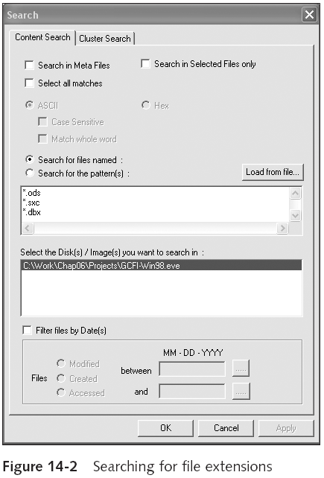
Guide to Computer Forensics and Investigations

Slide 24
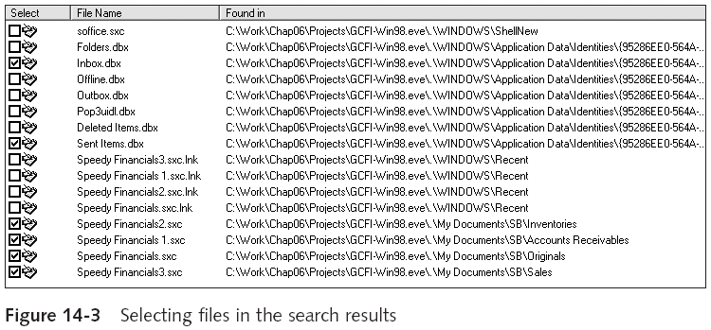
Using ProDiscover Basic to Generate Reports (continued)
Guide to Computer Forensics and Investigations

Slide 25
Using FTK Demo to Generate Reports
Create a new case
Add evidence to the case
Analyze evidence with FTK
  Look for image files
  Locate encrypted files
  Search for specific keywords
    Indexed search
    Live search
Guide to Computer Forensics and Investigations

Slide 26
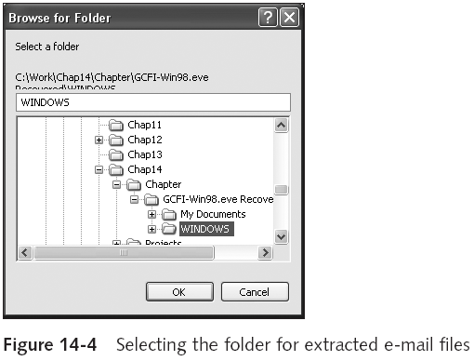
Using FTK Demo to Generate Reports (continued)
Guide to Computer Forensics and Investigations

Slide 27
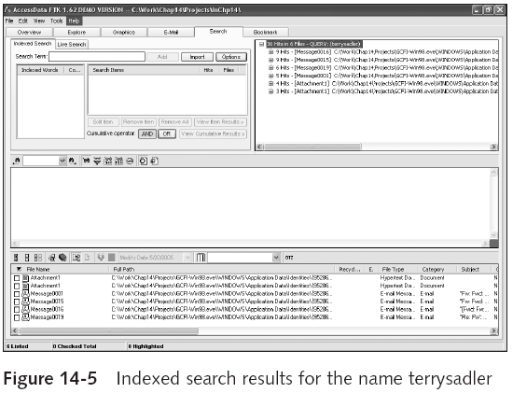
Using FTK Demo to Generate Reports (continued)
Guide to Computer Forensics and Investigations

Slide 28
Using FTK Demo to Generate Reports (continued)
Create bookmarks
Generate a report from your bookmarks
Guide to Computer Forensics and Investigations

Slide 29
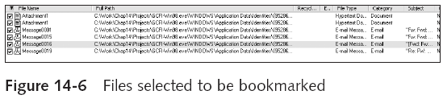
Using FTK Demo to Generate Reports (continued)
Guide to Computer Forensics and Investigations

Slide 30
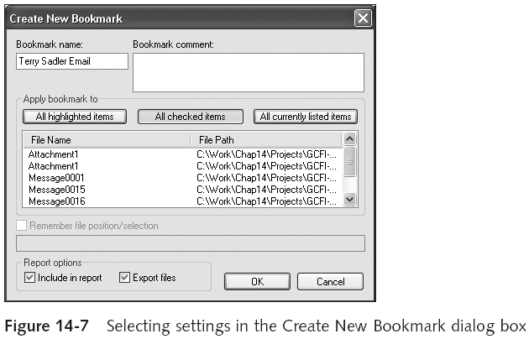
Using FTK Demo to Generate Reports (continued)
Guide to Computer Forensics and Investigations

Slide 31
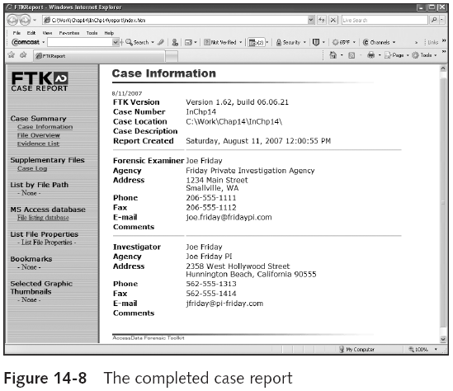
Using FTK Demo to Generate Reports (continued)
Guide to Computer Forensics and Investigations

Slide 32
Summary
All U.S. district courts and many state courts require expert witnesses to submit written reports
Attorneys use deposition banks to research expert witnesses’ previous testimony
Reports should answer the questions you were retained to answer
A well-defined report structure contributes to readers’ ability to understand the information you’re communicating
Guide to Computer Forensics and Investigations

Slide 33
Summary (continued)
Clarity of writing is critical to a report’s success
Convey a tone of objectivity and be detached in your observations
Guide to Computer Forensics and Investigations

